Slide 1
Read Me First! What is the Procurement Excellence Network?
The Procurement Excellence Network (PEN), an initiative of Partners for Public Good, is a free online hub to support public sector leaders as they drive reforms to procurement practices. Built by and for state and local government leaders, PEN offers tools, trainings, and resources and is completely free.
procurementexcellencenetwork.org
Our goal with resources such as this one is to offer a template that you can adapt to your own government’s needs. This slide deck is designed to support you along your journey toward procurement excellence by offering a template you can use to train potential vendors in how to best respond to government solicitations.
Notes:
For more information on the Procurement Excellence Network, please visit procurementexcellencenetwork.org
For more information on our four pillars of procurement excellence, please see our publication What is Procurement Excellence?
For a step-by-step how-to guide on writing RFPs, please see our resource Crafting a Results-Driven Request for Proposals (RFP)
* * *
The Procurement Excellence Network (PEN) is a free, online community for public sector leaders seeking to transform their jurisdiction’s procurement practices. It offers virtual trainings, tools, templates, and coaching, while building peer connections for leaders as they launch efforts to make procurement more strategic, fair, and innovative. PEN is an initiative of Partners for Public Good (PPG), a 501(c)(3) non-profit organization that helps state and local governments use key operational levers—procurement, workforce, digital infrastructure, and budgeting—to drive public impact.
Partners for Public Good is grateful for support from Bloomberg Philanthropies.
© Copyright 2025 Partners for Public Good

Slide 2
Read Me First! Framing for RFP/Solicitation Response Trainings for Vendors
We’re so happy you’ve decided to run an RFP/solicitation training for prospective vendors. Often vendors, especially small and diverse businesses, find the RFP process overwhelming and bureaucratic. A new process that’s hard to understand often discourages these businesses from even applying. But that doesn’t have to be the case! An open, recorded webinar on an RFP’s structure, content, and requirements will go a long way in making the process more accessible and, in turn, increasing the number of high-quality RFP responses from small and diverse businesses.
Some top-line considerations and reminders:
Emphasize how happy you are to see new, small, and diverse businesses participating: Show how much your government wants to partner with new vendors. Encouragement goes a long way!
Leave plenty of time for Q&A: Prospective vendors value open time with Purchasing staff to better understand the procurement process and build relationships with government representatives.
Customize these slides to your government’s needs: Everyone’s process and RFP is different, so feel free to add on the content or adjust our template slides to best articulate what YOUR Purchasing team needs for RFP responses.
Post the slides (and ideally recording) on your website: Live webinars are special in that they simultaneously engage vendors in the moment and create content. A presentation like this is a great resource for new vendors who may not be available to sit in on a live webinar.

Slide 3
Responding to Solicitations 101:
Feel free to add an icon or two of your government, government’s seal, and/or department/agency. You also can put this content into your government's slide template. Branding is encouraged!
How to Submit Strong, Compelling RFP Responses for [insert government name]
[Government] – [Month 00, 0000]
If a bullet, shape, or text box is highlighted in yellow, that means you should change the text to adapt to your government’s needs. Look at the notes for talking points. All other text you can keep as is! (And delete this box, of course.)
[Government] - [Month 00, 0000]
Notes:
FACILITATOR NOTES:
You can cover just RFPs, IFB/ITBs, or both in a training like this. Just keep it to an hour if you can.

Slide 4
Creating a Great Customer Experience
Making our procurement process as accessible and friendly as possible is a priority for the government name. We want your experience to be clear, efficient, and welcoming, no matter what service or product your firm or organization provides.
[insert seal from government]
We especially welcome businesses and organizations that are new to contracting with the government – we’re so glad you’re here!
Notes:
FACILITATOR NOTES:
Emphasize in your talking points how happy you are to see new businesses participate in this webinar. Encouragement goes a long way with diverse and small businesses.
PHOTO SOURCES:
Hands on table: https://www.pexels.com/photo/photo-of-people-near-wooden-table-3184418/
Woman with laptop: https://outsidein.org/evisit/person-using-a-laptop/

Slide 5
Responding to Solicitations 101 will cover…
WHAT: an overview of the Request for Proposal (RFP) document’s structure, content, and purpose. This presentation doesn't focus on other procurement types, such as Invitations to Bid (ITB).
HOW: guidelines for submitting RFP responses to the insert appropriate office correctly.
HOW: 5 tips for writing strong and compelling RFP responses that best highlight your firm or organization’s strengths.
GOAL: To learn how to respond to RFPs effectively and accurately, such that you present RFP responses that best highlight your firm or organization’s strengths.
Notes:
FACILITATOR NOTES:
Feel free to adapt the first bullet to the solicitations you want to cover. It can be RFPs, ITBs, or both.

Slide 6
Housekeeping
Have a question? Put it in the chat! We’ll save the last 15 minutes to address your questions and comments. We’ll also address questions in the chat over breaks during the “quiz” sections of the training.
Stay muted unless speaking.
This session will be recorded for future reference and posted on insert link to government’s website.
Notes:
FACILITATOR NOTES:
Leave time for questions! Vendors and providers find the open time with staff very valuable, and it’s a great way for your team to connect with the vendor community.
You can do this training live or virtually, but if it’s virtual, a reminder to stay muted is helpful.
Make sure to record the training and add it to your government's website. It’s a low-lift way to create educational content for prospective vendors!
If this is a small group training, you could include an icebreaker or time for each of the participants to introduce themselves.

Slide 7
What is an RFP?
RFP Overview
A problem to solve: An RFP is a document that the government uses to purchase goods and services in a fair, efficient, and transparent way. It also is a tool government uses to spend taxpayer money fairly and responsibly. The RFP will describe what is needed and expected from a vendor and what successful delivery of a service or product looks like.
A job description: The RFP will also lay out how candidates’ responses will be evaluated based on a set of criteria. RFPs are primarily evaluated on qualitative factors (e.g., experience, qualifications) and price.
An opportunity for innovation: Upon reading the RFP, you can reach out to procurement staff with questions and comments regarding the specifications or scope of work.
[insert images of your RFP]
Notes:
FACILITATOR NOTES:
This slide is an excellent opportunity to make clear to prospective vendors that they are partners in this work, not just executors. Setting this collaborative tone early is critical to receiving strong RFP responses.
Of course, adapt the last bullet to your government's buyer rules and regulations.

Slide 8
What does an RFP typically look like? What is the purpose of each section?

Slide 9
Cover Page
RFP Overview
Right away you know:
What the government wants
Commodity codes (which are key to finding what opportunities correspond with what your firm does)
[insert images of your RFP cover page]
The rest of the page tells you:
Key dates: pre-proposal conference, question deadline, proposal submission
Assigned buyer or purchasing staff
[insert images of your RFP cover page]
Notes:
FACILITATOR NOTES:
Providers find this intentional walkthrough of each section very helpful. It also helps you make sure readers don’t skip any key information.
Feel free to use whatever term is appropriate – buyer, purchasing staff.

Slide 10
Overview and Background
RFP Overview
[insert images of an example RFP overview and background]
These sections tell you:
What problem the government is trying to solve
Who are the intended users of the service or product
Why the government needs this service or product
What context and consideration a vendor needs to know about the purchase
Notes:
FACILITATOR NOTES:
Feel free to adjust the title/sections as needed to reflect your own RFP/solicitation.

Slide 11
Scope of Work
RFP Overview
This section tells you:
What activities, deliverables, and/or products the government expects to be completed during this contract
What requirements the government expects the vendor to meet
Why those activities and requirements are crucial to the RFP’s goals and outcomes
[insert images of sample RFP scopes of work]
Notes:
FACILITATOR NOTES:
Make sure to emphasize that a good SOW is explicitly connected to the goals laid out in the overview/background. Every piece of the RFP should connect clearly and readily.
Have a couple of example services/SOWs prepared to incorporate into your talking points.

Slide 12
Performance Metrics
RFP Overview
This section tells you:
How the government will be tracking vendor performance and progress towards outcomes
Who will collect those metrics and how often
How the government will engage with the vendor during the contract
[insert images of sample RFP performance metrics]
An RFP is NOT the contract – the final performance metrics will usually ultimately be determined by the awarded vendor and the government jointly.
Notes:
FACILITATOR NOTES:
Emphasize here that the performance metrics will be connected to the goal.
The contract may have FINAL say over the metrics and their oversight, but the final product will look very similar to the RFP.
Have a couple of example performance metrics prepared to incorporate into your talking points.

Slide 13
Evaluation Criteria
RFP Overview
This section tells you:
How responses are evaluated: The RFP will list various categories, each with a point value, and a basic description of what a top score looks like. Typically, points add up to 100.
Again, RFPs are primarily evaluated on qualitative factors and price. These can include:
Qualifications and experience
Service delivery
Staff capacity and training
Familiarity with project context or recipients
Past performance
[insert images of sample RFP evaluation criteria]
Notes:
FACILITATOR NOTES:
If you’re covering both RFPs and ITBs in this training, you may want to split this slide into two: one for RFPs, the other for ITBs.
Emphasize that point values signal to the reader (vendors) what a government cares most about.
Explain that the qualitative factors assessed vary by services. Program staff work with procurement teams to determine the right set of factors and weights.

Slide 14
Proposal Content and Responses
RFP Overview
This section tells you:
What written content or responses you need to provide to demonstrate your qualifications
What the government will use to determine your “score” on various evaluation criteria to determine the strongest RFP response
[insert images of sample RFP response question and forms]
Our goal is to keep things simple and accessible: all respondents answer the same questions or prompts in the same manner to share their qualifications and strengths.
Notes:
FACILITATOR NOTES:
Response forms are the documents jurisdictions use to standardize RFP responses, especially for qualitative assessments of services. Think of it as a worksheet that bidders use to make sure they cover all the necessary information for their bid response.
Here too the types and number of response questions and materials will vary by service and scope.
The simplicity and accessibility point is important. Model/demonstrate to vendors that you value their user experience.

Slide 15
Quiz Time!
What are RFP responses evaluated on?
There are no evaluation criteria - responses are selected based only on cost.
Responses are primarily evaluated on qualitative factors, such as past performance and staff capacity, and price.
Responses are evaluated based on the quality of the government’s relationship with the proposer and how well you know each other.
You can choose to “opt out” of certain evaluation criteria and not be evaluated on some components.
Notes:
FACILITATOR NOTES:
B is the correct answer. Feel free to change the question too! The key is just having a small, interactive activity to check for comprehension.

Slide 16
So how do I respond to an RFP correctly? How and what do I need to submit?

Slide 17
What should ALWAYS be in my RFP response?
RFP Response Submission
EVERY RFP response requires:
Cover letter
Respondent information sheet
Proposal response form/written proposal narrative
Price summary sheet
Any additional information (recommendations, materials) required by the RFP.
[insert image of checklist/response form for your RFP]
Supplementary materials vary greatly between RFPs. Make sure to read the checklist included in your RFP.
Notes:
FACILITATOR NOTES:
Adjust the RFP response requirements by the needs of your government.

Slide 18
How should I submit my RFP response?
RFP Response Submission
Reserve this slide for explaining how to digitally or physically your RFP/solicitation responses.
Notes:
FACILITATOR NOTES:
People often get tripped up on RFP submission, so take time to answer any immediate questions.
Also, this is a good time to highlight the steps taken by your government to make the submission process easier. If not, we encourage you to consider whether there are simple steps you can take to make the submission process easier, such as making the submission information publicly accessible and removing any fees associated with vendor registration.

Slide 19
Quiz Time!
Which of these statements is TRUE?
Add 4 options for a quiz question about RFP submission – this will depend on your government!
Notes:
FACILITATOR NOTES:
Make sure to write down the right answer here for reference!

Slide 20
5 Most Common Errors Proposers Make in RFP Responses

Slide 21
1. Not Including the Right Documents
5 Most Common Errors
Make sure to read the respondent checklist carefully: include in your RFP response ALL the materials requested. No more, no less. If all the required documents are not included, you will be considered non-responsive.
[insert an image of the checklist you common include in your RFP or solicitation]
You also don’t get any extra points for attaching material that was not asked for! Only include materials listed on this checklist!
Notes:
FACILITATOR NOTES:
Recap again some of the required materials you discussed in the previous sections.

Slide 22
2. Not Customizing Your Response to the Government's Needs
5 Most Common Errors
Procurement staff can see a “copy-paste” job from a mile away. Don’t recycle, customize! Make sure that your RFP response genuinely responds to the questions asked and demonstrates how your firm can meet the government's needs, not any client’s. Check that you’ve addressed all evaluation criteria.
Notes:
FACILITATOR NOTES:
Recap again some of the required materials you discussed in the previous sections.
PHOTO NOTE:
Desk image: https://www.pexels.com/photo/people-working-in-front-of-the-computer-3184357/
Keyboard: https://www.istockphoto.com/photo/keyboard-with-customize-orange-button-gm185895589-28184736

Slide 23
3. Not Featuring Specific Examples in Your Response
5 Most Common Errors
One of the best ways to demonstrate your value-add as a vendor is to share specific examples of how your services address our needs.
Don’t rely on generic descriptions and vague promises! Answer the RFP response questions using examples of past projects or descriptions of your approach. If you’re a new vendor in this space and can’t draw on many past examples, describe the unique approach your firm or organization will bring to the project.
Notes:
PHOTO NOTES
Writing on laptop: https://bestwriting.com/blog/best-laptops-for-writers

Slide 24
4. Sharing Overly Lengthy Responses to See “What Sticks”
5 Most Common Errors
Longer responses do not mean better responses! We like brevity. Focus on the questions being asked. If 150 words answer the question, then a 1000-word responses only make it harder for the government to read and review your proposal in a timely manner.
Notes:
FACILITATOR NOTES:
Feel free to adapt the advice listed here as you see fit!
PHOTO NOTES
Man looking at long paper: https://www.istockphoto.com/photos/man-holding-long-list

Slide 25
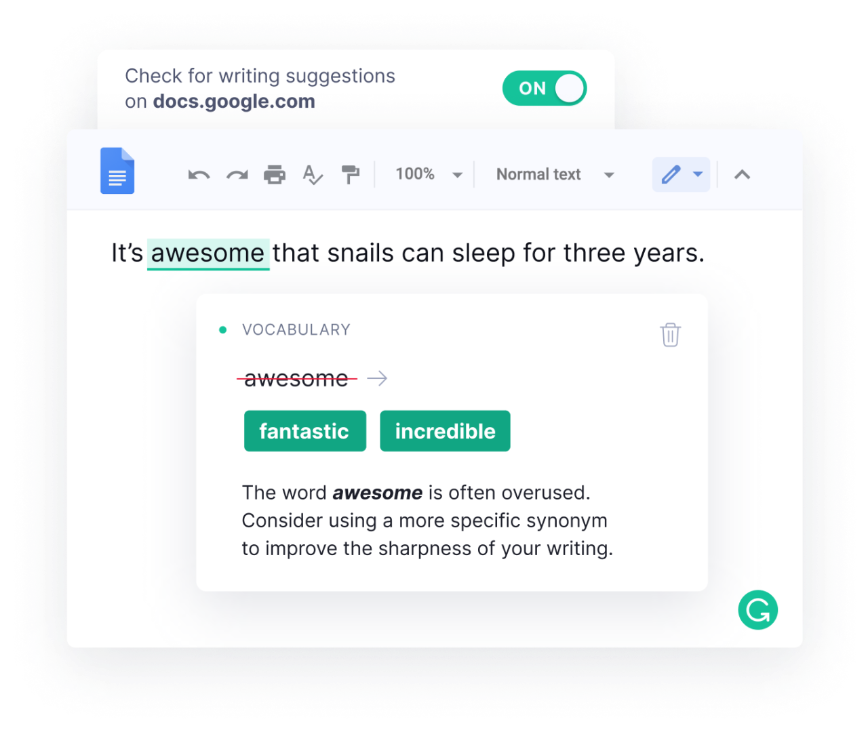
5. Forgetting to Review Before Submission
5 Most Common Errors
You’d be surprised to see how many error-filled RFPs the government receives. Make sure to:
Do a proper spell check.
Review formatting and grammar.
Remove Track Changes and Google Doc comments.
Ask colleagues to review your RFP response and confirm that you included all the necessary materials AND demonstrate that you meet the specifications.
Notes:
FACILITATOR NOTES:
This includes checking insurance and reference requirements.
PHOTO NOTES:
Awesome: https://www.grammarly.com/browser/chrome
Editing by hand: https://prowritingaid.com/art/1199/all-about-development-editing%2C-proofreading%2C-and-copy-editing.aspx

Slide 26
Quiz Time!
What should you review before submitting your RFP response?
Whether your responses answer the questions asked in the RFP and address government's needs
Spelling and grammar
Whether or not you included the right attachments
You should review all these components before submitting!
Notes:
FACILITATOR NOTES:
D is the correct answer. Feel free to change the question too!

Slide 27
Thank you!
Questions? Comments?
We’re so happy you joined this training and are looking forward to your RFP/solicitation responses. We will save the slides and the recording on our website for future reference. You can also reach out to the Purchasing team at any time at [insert email or phone number(s)].
Notes:
FACILITATOR NOTES:
Make sure to leave plenty of time here for Q&A – at least 10 minutes. Vendors find this open time with Purchasing staff tremendously valuable.
Save your training (and slides!) to the government's website. Now you have a self-contained resource you can share with new vendors when they connect with you over email or phone!
Note again how happy you are to see new faces in the room, and that the government wants to work with new and diverse vendors. Encouragement goes a long way.

Slide 28
Liked doing this webinar? Want to add some additional content? Here are topics to consider:
When does a government issue an RFP? In what cases would another procurement method be used (three quotes, sole source)?
What happens after I submit my proposal?
Who from the government will be responsible for reading my proposal and evaluating it?
What kind of notice and/or feedback should I expect to receive if I did NOT win the contract?
If I win the contract, what other documentation or support materials should I expect to submit prior to contract start? How can I prepare myself for contracting with government?

