Slide 1
Setup and Notes
Timing: 1 hour and 15 minutes
Participants: At least one group of 3-5 participants
Notes: Before you start, have participants sit in groups of 3-5.
Materials (Participants): Contract Excerpt (you can print a copy for each participant), Worksheet, pen or pencil.
Materials (Facilitator): Timer, Worksheet Answer Key.
You’ll alternate between sections of content delivery and prompting group activity work. Keep your timer handy!
When the groups are doing activity work, feel free to float around to offer support or insight.
Check each section’s Key Concept Pre-Read in the notes to familiarize yourself with key points before facilitating.
Section | Slides | Timing
Overview | 1-5 | 14 min
Proactive Contract Management | 6-9 | 6 mins
Developing Metrics | 10-14 | 11 mins
Risk Assessment | 15-21 | 11 min
Data Deep Dive | 22-26 | 15 mins
Vendor Engagement | 27-29 | 5 mins
Discuss and Reflect | 30 | 10 mins

Slide 2
Keeping Cloud City Clean
Proactive Contract Management Simulation
Partners for Public Good: Executive Education Team
Notes:
Facilitator Notes
Welcome & buffer time…
Welcome to today's session on Proactive Contract Management. The session will be highly interactive, so your full attention and participation are appreciated.
[Make sure participants are sitting in groups of 3-5. You can give or take a few depending on group size.]

Slide 3


Welcome to Cloud City…
Lagging Janitorial Services
18 out of 25 buildings have generated concerns about cleanliness.
Staff say…
“Janitors empty the trash but don’t change the liner, which attracts fruit flies.”
Residents say…
“As a small business owner, I hate the dingy feel of City Hall when I go to renew my permits.”
Notes:
Overview Section - Key Concept Pre-Read
Creating public value is the process and practice of solving a problem in the public realm through investing in resident wellbeing. It involves producing goods or services that benefit individuals in order to create outcomes that benefit society as a whole.
Effective contract language includes both output and outcome metrics.
Output metrics answer “What did the vendor do?” and outcome metrics answer “Did the vendor’s work bring about the desired result?”
Outcomes are a valuable tool for measuring the creation of public value.
The Contract Excerpt contains both types of metrics.
Facilitator Notes
Welcome to Cloud City, a small jurisdiction with a big problem.
Cloud City has a portfolio of municipal buildings like libraries, offices, and community centers that are falling into disrepair due to janitorial services not being up to snuff or not being completed at all.
Today you’re going to serve as consultants to the General Services Department, helping them review the contract they signed 6 months ago that just isn’t working out. You’re going to work in groups to analyze different portions and share your recommendations.
Aside from the pictures of the buildings themselves, we’ve pulled some data on the situation. Of Cloud City’s 25 municipal buildings, 18 of them have generated complaints about hygiene and cleanliness. That’s 72% of buildings. You can see here what some building users say about their concerns.
Hopefully none of you have ever had to work in conditions like this! But has anyone ever had to "rescue" a contract with a vendor that wasn't working out? Or wondered in hindsight if you could've managed an unsuccessful contract more skillfully?
[Take responses, affirm – 2 minutes]
Today we're going to get into ways we can avoid having to do damage control on contracts by becoming more proactive in our approach to writing the contract itself, as well as thinking about risks in advance.
We're also going to work through the types of data we can capture to monitor vendor performance, and questions we can ask along the way to make sure that a vendor is on track or uncover where support might be needed.

Slide 4
What’s the public value of successfully managing this contract?
Notes:
On that note, let’s start with examining the impact of these poor janitorial services.
What do you think is the importance of solving this issue? In other words, what kind of public value would it bring to Cloud City?
[Take ideas from the group – 1 minute. Affirm responses.]
Using our ideas about what value that solving this problem would bring to Cloud City, we can start to form some preliminary goal language for this contract.
This is a mindset you can bring to your own contracts- one of thinking about service goals from the very beginning. And once that goal is clarified, it anchors the opening of your contract as a “north star” to hold both parties accountable.

Slide 5
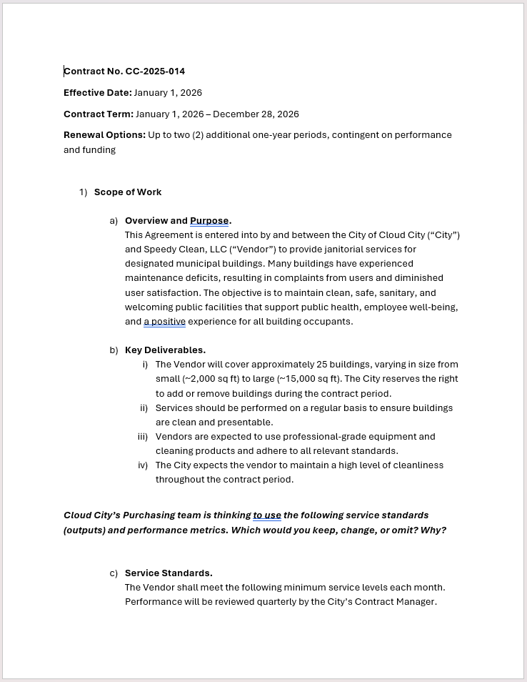
Contract Readthrough
Think…
What works?
What’s vague or unclear?
Notes:
Now let’s take a moment to read through an excerpt of Cloud City’s actual contract. Skim the contract, which is first in your packet. When you're done, share out what you think works about this contract, and anything you found to be vague or unclear.
[Give a minute for them to skim, and take responses for about 2 minutes.]
People may highlight:
In the Overview and Purpose section, the lack of a goal may read as unclear.
In Key Deliverables, “regular” and “periodic” may read as unclear, as should “adhere to all relevant standards” and “high level of cleanliness.”
In Reporting Requirements, the reporting mechanism is unclear.
Or they might find that it “works” to have metrics in the first place, but it’s not helpful if those metrics are unclear.
[Synthesize what you heard and affirm comments that relate to the above - 1 minute]
Keep everything that you spotted in mind. While it is important to leave freedom for the vendor to use their best judgment, it’s also important to be aware of risks that can arise when key areas of the contract aren’t considered in advance.
And overall, if you caught the absence of clear metrics, you’re on the right track. So our first task is to help General Services staff draft some solid metrics for this contract.

Slide 6
Proactive Contract Management
Notes:
Proactive Contract Management Section - Key Concept Pre-Read
Passive contract management focuses on compliance. Results are not usually reviewed until the end of a contract.
In contrast, proactive contract management involves regular review of data and communication with the vendor to troubleshoot issues as they arise.
Facilitator Notes
We’re going to do this through a more proactive contract management approach.

Slide 7
Proactive Contract Management
01 | Alignment on contract goals and expectations
02 | Assessment of risks, challenges, and barriers
03 | Regular performance meetings
04 | Clarity on metrics and KPIs
05 | Real-time performance review
Notes:
A proactive approach is one that uses a collection of strategies to set a clear vision for contract success, assess risks and barriers, prioritize intentional relationship building, and engage in regular data-informed conversations with vendors to support successful contract performance.
Being more proactive means troubleshooting reactively to realize incremental improvements. And a key feature is setting contract metrics that balance compliance and performance.
I want to emphasize that including metrics in contracts is a key step towards procurement excellence and one that benefits many cities to adopt.
It’s important to include metrics when possible because they are an extension of your contract’s goal. So if Cloud City’s goal is to have clean, safe, and welcoming municipal buildings, there should be a set of metrics...

Slide 8
Proactive Contract Management
01 | Alignment on contract goals and expectations
02 | Assessment of risks, challenges, and barriers
03 | Regular performance meetings
04 | Clarity on metrics and KPIs
05 | Real-time performance review
Answers these questions…
Are vendors being accountable to the work?
What’s working? What’s not?
How do we replicate success?
Notes:
...that answer questions about accountability for vendors and allow discussion of what’s working and what’s not.
And even though it may seem easy to set binary metrics that check whether something simply was or wasn’t accomplished, a simple yes/no approach would limit your visibility into where there’s room for improvement, and how to replicate success.

Slide 9

Passive vs. Proactive Contract Management
PASSIVE
PROACTIVE
What patterns are we noticing this month?
We’ve received more complaints on our janitorial services.
It looks like all six of our vendors submitted their invoices and reporting on time this quarter. I don’t see any violations that concern me.
When breaking down the data, it looks like only Vendor E is receiving more complaints. Let’s schedule a site visit with them to learn more about their challenges and brainstorm solutions.
Great. Let’s share what we learn with the other vendors so they can avoid the issues Vendor E experienced. And when we review this data again next month, let’s check if any of our solutions helped reduce Vendor E’s complaints.
Great. File it away and send them a thank you email.
Notes:
Let's take a look at what those metrics, combined with a proactive approach, can help us do.
A traditional “set it and forget it approach” may look and sound like the example on the left. But a proactive contract management process would take it a step further, moving past just compliance to dive deeper—which may look like the example on the right.
Do you see the difference? Have you ever observed contracts being managed in the set-it-and-forget-it style of the first example?
[Take comments – 2 minutes]

Slide 10
Developing Metrics
Notes:
Developing Metrics Section - Key Concept Pre-Read
Contracts should contain metrics that are relevant, accessible, straightforward, and timely.
Output metrics focus on quantity, whereas outcome metrics focus on quality.
Facilitator Notes
Now, let’s talk about metrics you can use for your own contracts.

Slide 11
Effective metrics are…
Above all…
Relevant
Accessible
Choose practical metrics that are tied to your contract goals.
If you can’t track it, collect data on it, or explain it…
it’s not a quality metric! ​
Does the metric tell us something important about the contract?
Can this data be collected from available sources?
Easy to Understand
Timely
Is the metric simple enough to explain to a broad audience?
Will you to be able to measure changes in this metric on a regular basis?
Notes:
As you think about what data to collect from vendors, there are four characteristics of effective metrics you should keep in mind.
First and foremost, metrics should be relevant to your contract goals. A good metric will help you understand which contracts are meeting these goals and which ones are not.
Secondly, metrics should be accessible, which means they rely on data that's realistic to collect, and data sources that are readily available.
Third, the best metrics are straightforward and easy to understand without much explanation. A great test is to ask yourself: If this metric was a headline in your local newspaper, could the average person understand it without reading the article?
Lastly, metrics should be timely and should change just enough to help you proactively course correct. If a metric doesn’t change very often, then it may not be that useful to track.
The theme here is to avoid creating busy work for your staff and vendors, and instead select metrics that are practical, intentional, and directly tied to your contract goals.

Slide 12
Balance outputs and outcomes
Outputs
Measure actions or items delivered by the vendor that contribute to an outcome
Assess quantity, timeliness, & cost of services
Often available in the short term
Outcomes
Measure intended results and added value for residents
Support understanding of impact and quality of services
Available only in the long term and may be challenging to collect data on
Notes:
There are two different flavors of metrics that we categorize as outputs and outcomes.
Outputs measure how many goods or services are delivered and can also reflect how much work a vendor performs, and for how long.
On the other hand, outcomes measure the impact of that work and focus on whether or not residents are better off as a result of these goods or services.
The easiest way to distinguish between these two categories is that outputs focus on quantity, while outcomes focus on quality.
A fun example: If you ordered a cake from a vendor for an office party, outputs could be the size of the cake and the number of people it can feed.
But outcomes would focus on the impact of the cake, like whether your team enjoyed it, whether they want to order the cake again for more office parties, and whether it helped people feel celebrated and more motivated working in the office.

Slide 13

Example Performance Metrics
What performance metrics would you include in a janitorial services contract?
SERVICE | OUTPUT | OUTCOME
Janitorial Services | # of square ft. cleaned …what else? | % increase in visitor satisfaction …what else?
Notes:
Let’s think through a more practical example.
What output and outcome metrics would you track for a janitorial contract?
Let’s hear one guess for outputs, and another guess for outcomes.
[Affirm as needed – 2 minutes]
[Some ideas:
Output: # of sq ft cleaned; % of cleaning requests completed timely
Outcome: % increase in building visitors, % increase in visitor satisfaction ratings]
Those were all great guesses. Let’s keep building on this great start by looking more closely at the metrics in Cloud City’s contract.

Slide 14
What output and outcome metrics would you suggest for the Cloud City contract?
Notes:
At your table, please discuss: What output and outcome metrics would you suggest for the Cloud City contract?
You can consider: what would you keep, change, or remove entirely? We’ll give you four minutes to discuss and I invite you to use your worksheet to take notes. Go ahead and start now.
[Put four minutes on the timer.]
Let's have a group share out! Take two minutes to describe your metrics and why you chose them.
[Choose a group and hear their responses; affirm. – 2 minutes]
Now let's move into talking about risk assessment.

Slide 15
Risk Assessment
Notes:
Risk Assessment Section - Key Concept Pre-Read
Risks are possible events that may adversely affect contract goals, whereas challenges are immediate issues requiring remediation.
A risk matrix can help assess both the probability of a risk occurring, and the impact intensity if it were to occur.
The likelihood and intensity of the contract’s risks should inform your contract management approach.
Facilitator Notes
Risk analysis is a crucial part of the contract management process in which you identify and evaluate possible barriers, uncertainties, and external factors that may hinder progress.

Slide 16
Diagnosing risks and challenges
Risk
A possible event that would adversely affect the achievement of objectives in your contract.
Challenge
An active issue that is impacting the contract, requiring immediate or planned remediation.
If we don’t specify the number of sites to be cleaned, we could incur unexpected service charges.
It turns out the survey portal that the vendor built isn’t compatible with our City systems.
Notes:
For the sake of today’s discussion, we’re defining risk as a possible event that could adversely affect your achievement of the goals, outputs, or outcomes you just laid out in that theory of change.
Whereas a challenge is an ongoing issue that is actively affecting your project right now and requires immediate or planned remediation.
So a challenge is something that’s definitely happening or going to happen, and a risk is something that might happen. We’re going to focus on risks today.

Slide 17

Type of Contract Risks
Scope and Performance
Cost Increases and Delays
Project faces unforeseen conditions, is not delivered, or is delivered to a poor-quality standard.
Project is over budget, requires frequent change orders, faces inflation for materials, or is rescoped, causing delays.
Legal and Compliance
Political and Reputational
Project fails to comply with requirements and risks litigation.
Project failures reflect poorly on elected and appointed leadership.
Notes:
There are many different kinds of risks. For example:
Scope and performance risk relates to uncertainties regarding what the contract is expected to deliver, such as changes in project scope that could affect your timelines, costs, or overall outcomes.
We’ve all heard or experienced horror stories of projects that started out small and then ballooned into something much larger than intended.
For example, expanding the number of sites to be included in a contract, or requiring maintenance services in addition to installation. This scope creep can lead to invoicing complications, higher costs, poor relationships with vendors, and other contract issues.
Cost increases and delays may occur when the project runs over budget or requires pricey change orders. This may happen due to circumstances outside of your control, like inflation or extreme weather events in the case of a construction project, or they could cascade from scope and performance issues.
Legal and compliance risk is on a lot of folks’ minds right now given federal grant requirements. This is the risk of your project not complying with funding requirements, which could result in litigation or having the funding clawed back.
Political and reputational risk occurs when your contract fails to produce the desired results and damages the reputation of your government and elected or appointed leaders.
There are definitely other kinds of risks out there, but these are particularly common.

Slide 18
Impact vs. Probability
Impact Scale
 | Negligible | Marginal | Critical | Catastrophic
High (Very Likely)
Medium (Probable)
Low (Improbable)
Probability Scale
Your contract risks:
Yellow Area
Orange Area
Red Area
Your approach:
Low Intensity
Medium Intensity
High Intensity
Notes:
One common tool in risk assessment is a risk matrix, which allows you to compare the likelihood of a risk occurring with its potential impact on the project.
The X-axis assesses impact, or the potential consequences if this risk does materialize. The spectrum ranges from negligible – meaning little to no impact – to catastrophic, meaning you’ve got a big, big problem on your hands.
Probability or likelihood is measured on the Y-axis from low to medium to high. You should consider factors such as regulatory changes, staffing, market shifts, and anything else that could affect operations.
So when evaluating your contract’s risks, keep in mind that there is no specific rubric or evaluation criteria for classifying your risk as catastrophic or negligible or as highly likely or highly unlikely. Use your best judgment and expertise in assessing risks, and keep in mind the unique context of your situation and your appetite for absorbing risk.
In general, if your risks are high-impact and high-likelihood and fall into the red zone, your contract management approach should probably be more high-intensity.
But if your risks fall into the yellow zone, it likely isn’t worth the effort to take on a high-intensity approach.

Slide 19
Risk (and Performance) Management Approaches
Low Intensity | Medium Intensity | High Intensity
Kickoff meeting to establish roles and responsibilities Quarterly check-ins with vendors (virtual or on site) Progress or status reports | Comprehensive kickoff meeting and early investment in relationship-building Orientation / training for vendors Consistent monthly meetings to discuss performance and course-correct Identification of key performance indicators (KPIs) to track progress | “Lemon squeeze” listening session with vendors to discuss pain points Bi-weekly meetings to review KPIs and troubleshoot performance issues Disaggregating data to understand service gaps
Notes:
Once you’ve assessed your contract risks, you'll want to determine the right-sized contract management approach.
For lower-intensity projects, you may not need as many safeguards, and you’ll want to reserve greater project management capacity for higher-risk projects.
For high-risk, high-complexity contracts, you'll want to be deeply engaged in vendor oversight and focus on proactive problem-solving and performance tracking.
Keep in mind that your approach may evolve at different points in the contract depending on how your risks manifest, so don’t lock into one column of activities for the entirety of your contract.
The key takeaway here is that the contractor isn’t the only one responsible for making your project a success. You as the contract owner should also plan to take an active role in project oversight.

Slide 20
Cloud City CPO says…
RISK | WHERE | COMMENT
Scope & Performance | Scope of Work | “’Regular’ and ‘presentable’ are vague. Without set frequencies and standards, vendors could under-deliver.”
Cost Increases & Delays | Key Deliverables | “How will pricing and staffing adjust if buildings are added or removed? Without adjustment terms, we could overpay or underserve.”
Political & Reputational | Performance Metrics | “How will performance data be collected and shared? What if inspections rating cleanliness as ‘Unsatisfactory’ are leaked to the media?”
Scope & Performance, Legal & Compliance | Performance Metrics | “Is a 2-hour urgent request response feasible across all sites, at all hours? What counts as urgent?”
Cost Increases & Delays, Legal & Compliance | Reporting Requirements | “Should we specify what portion of payment is subject to withholding? Vagueness could lead to disputes.”
Notes:
In the case of Cloud City, you’ve now helped refine the contract goals and metrics. When you send off a draft to the CPO, she comes back with the following comments. Take a moment to skim.
Now each group will be assigned one of these risks. For your given risk, determine its probability level, possible impact level, and some options for Cloud City staff to mitigate it.
Group 1, take the first risk, Group 2 take the second, and so on.
[If there’s just one group, they may choose which risk to work on. If there are more than five groups, have more groups work on one of the risks.]
3 minutes for this activity.

Slide 21
For your risk, describe the probability, impact, and mitigation.
Notes:
Let’s have one group volunteer to share out. Take two minutes to describe to us your risk, probability, impact, and mitigation strategy.
[Take responses and affirm or correct as needed. - 3 minutes]
The most important thing is to use data to assess and mitigate risks! We’ll turn our attention towards that next.

Slide 22
Data Deep Dive
Notes:
Data Deep Dive Section - Key Concept Pre-Read
Regular data collection should inform ongoing conversations with vendors about performance highlights and challenges.
Examine trends in vendor performance to develop questions for check-ins.
Facilitator Notes
Now that you’ve identified risks and defined metrics to manage your contract, the Department Director at Cloud City took all your smart recommendations and renegotiated its contract.
The vendor has been working on this janitorial contract for 3 months. So, let's dive into the data to see how the vendors are performing.

Slide 23
Three months in…
Target: 90%
Target: <10
Notes:
Three months in, we have the following data for staffing and for complaints submitted.
Before I send you back into your groups, let’s glance at these two charts together and come up with some initial observations and questions you’d ask your vendor to better understand these trends.
Looking at these two charts: What trends are you noticing?
[Take responses and affirm – 2 minutes]
They could highlight:
higher staffing in July (perhaps more summer employee availability)
library has the lowest staffing overall
high number of complaints in June for the library
aside from the library, vendors are meeting or surpassing the target levels for staffing and number of complaints
Based on those trends, is there any more data you’d want to collect or a question you’d want ask your vendor to improve performance?
[Take 1-2 answers and affirm – 2 minutes]
Thanks for those insightful reflections and questions. Any trends you find, or questions you have can be helpful for starting a conversation with vendors to troubleshoot a solution.

Slide 24
Three months in…
Target: 90%
Target: <10
There may be a correlation between staffing shortages & facility complaints at the Downtown Library.
The Downtown Library had a lot of complaints in June. Were there trends among the 14 complaints?
Notes:
To build on this a bit, here are a few more directions you could go in.
More observations & questions:
There may be a correlation between staffing shortages and complaints at the library.
The library had an unusually high number of complaints in June. A question you could ask the vendor is “what are the most common types of complaints?” (e.g. trash in common areas, spills that need urgent attention, restroom cleanliness not up to par: no soap or paper towels.)

Slide 25
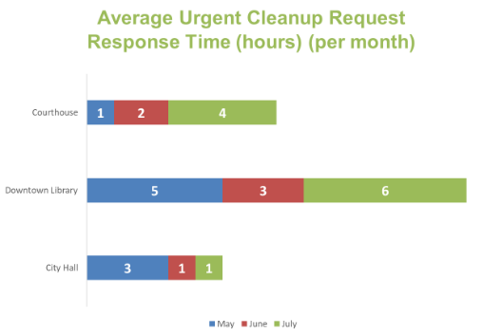
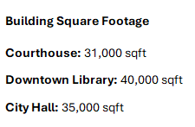
Three months in…
Target: ≤4
Notes:
I’ll also point out that there are two more data sources on your worksheet: 1) A chart about response times and 2) information about the size of each building.
On this response time chart, I want to point out that the Library is in fact meeting its target response time in June for urgent clean up requests.
So, I encourage you to consider all four data sources and the target metrics as you come up with more questions for your vendors.
Now we’ll break into groups to take a closer look at the data and brainstorm a few more questions to ask your vendors, or refine questions we already mentioned.
You’ll have five minutes, and you can use your worksheet to take notes.
[Set 5 minutes on the timer.]

Slide 26
What questions would you ask each vendor?
Notes:
Let’s have a group share out. What questions did you come up with and why?
[Affirm or correct as needed - 2 minutes]
Potential responses:
How do you allocate staff across the three buildings? Is it possible to reallocate staff based on peak usage or square footage?
What qualifies as an urgent cleanup request?
What types of complaints are most common for each building? Can you disaggregate the complaints by type?
Do certain areas of the building require more cleaning than other areas? (common areas vs. storage areas, or library staff offices)
Are these complaints all unique, or do they include duplicate reports of the same issue?

Slide 27
Vendor Engagement Meetings
Notes:
Vendor Engagement Meetings Section - Key Concept Pre-Read
Kickoff meetings, ongoing performance check-ins, annual performance reviews, site visits, corrective action meetings, and closeout meetings are all options for engaging with a vendor throughout a contract.
Performance check-ins can help you build a relationship with the vendor and collaboratively problem-solve throughout the contract.
Facilitator Notes
You all came up with very thoughtful questions to ask your vendors. Now let’s walk through the different types of meetings you can have with vendors where you'd ask these questions.

Slide 28
Types of Vendor Engagement Meetings
Meeting Type | When It Happens | Why It’s Important
Kickoff Meeting | Typically, within 1-2 weeks of contract execution | Clarify expectations, scope, and timeline with the vendor, sets tone of open communication and partnership, vendor is quickly brought up to speed.
Performance Check-In Meetings | Ongoing (weekly, bi-weekly, or monthly) | Build trust and relationships with key contacts in a more informal setting. Review progress, address issues, and ensure alignment.
Annual Performance Review | Once a year | Formal evaluation of contract outcomes and vendor performance over the course of a year.
Site Visit | As-needed | Site visit to assess service delivery and engage with worksite staff.
Corrective Action Meeting | As-needed | Address vendor underperformance or noncompliance and establish performance improvement plan.
Closeout Meeting | End of contract term | End of contract meeting to review final deliverables and lessons learned.
Notes:
As you likely know, there are many ways to engage with vendors throughout a contract.
There’s typically a kickoff meeting at the start of the contract to set clear expectations; ongoing performance check-ins throughout the contract term; and annual performance reviews once a year.
Some contracts also have a few site visits, and if an issue arises, you may need to have a corrective action meeting as well.
Lastly, towards the end of a contract it’s best practice to have a closeout meeting to review final deliverables and assess what went well and what could go better if the vendor bids on projects in the future.
[click to advance the animation]
Today, let’s zoom in on preparing for a performance check-in meeting.
Your performance check-in should have a few goals. If it’s within the first few months of the contract, you should focus on building a relationship with the vendor so that you can collaboratively problem-solve together if issues arise down the line.
As you move further along in the contract, you’ll shift to reviewing progress, data trends, and addressing any issues if needed.

Slide 29
What topics, insights, and questions would you discuss at this meeting?
Notes:
Imagine you are preparing for a meeting with the vendor who won the janitorial contract. In this example, the vendor's name is Tidy Solutions, Inc.
On the last page of your worksheet, you’ll see a list of potential topics to discuss with this vendor.
You’ll have one minute to check off which topics you would include for your three-month performance check-in.
Just to give you a hint, any of these topics may be helpful to discuss with your vendor, but some of them may be better suited for a different type of meeting than a three-month performance check-in.
Alright, one minute on the clock! [Time 1 minute.]
Now let’s see how we did.
[Choose a volunteer to share the talking points they chose. - 2 minutes ]
[If they got them all, say so. If their choice is incorrect, briefly explain why (refer to answer key)]
APPROPRIATE ANSWERS:
Option 2: Explore a possible connection between the 5% decline in staffing and user satisfaction dropping by 3%.
Option 5: Updates on the contract deliverables and the upcoming 6-month milestone.
Option 6: Discuss ways to overcome the barrier of patrons reporting noisy cleaning activities.

Slide 30
Making Connections
What elements of proactive contract management do you use in your daily work?
What could you consider incorporating?
Are any contracts good candidates for piloting some of these measures?
Notes:
As we wrap up, I’d like to ask, what elements of proactive contract management that we discussed do you use in your daily work?
[Take responses, affirm. - 2 minutes]
If there are any contract management practices we discussed that you don’t already use: What could you consider incorporating?
[Take responses, affirm. - 2 minutes]
What contracts may be good candidates for piloting some of these proactive contract management practices?
[Take responses, affirm. - 2 minutes]

Slide 31
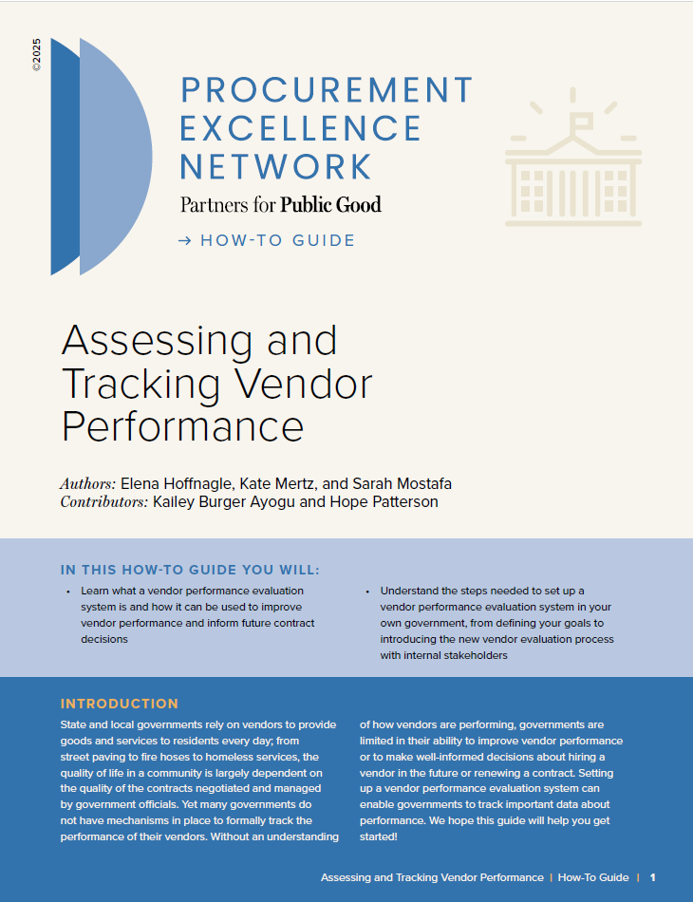
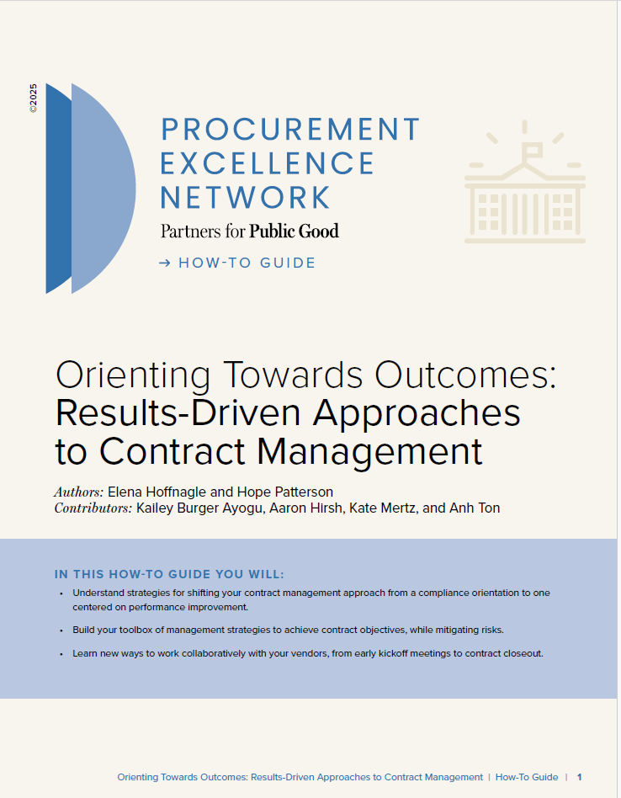
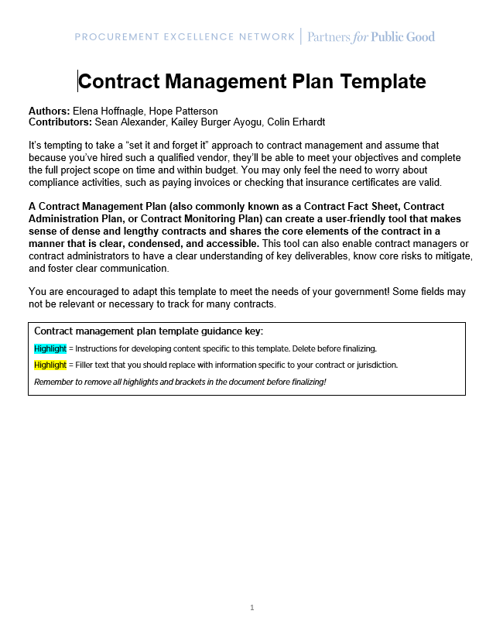
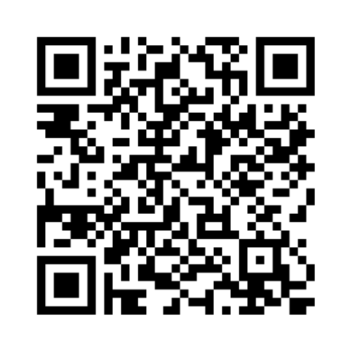
Check out these Procurement Excellence Network resources!
How-to Guide:
Assessing and Tracking Vendor Performance
How-to Guide:
Results-Driven Approaches to Contract Management
Template:
Contract Management Plan Template

Slide 32


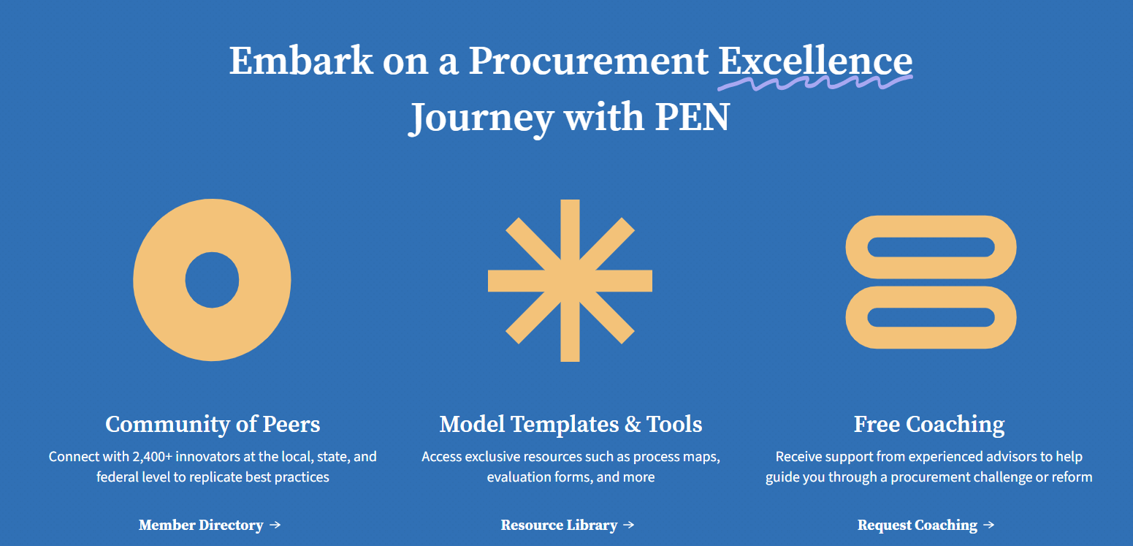
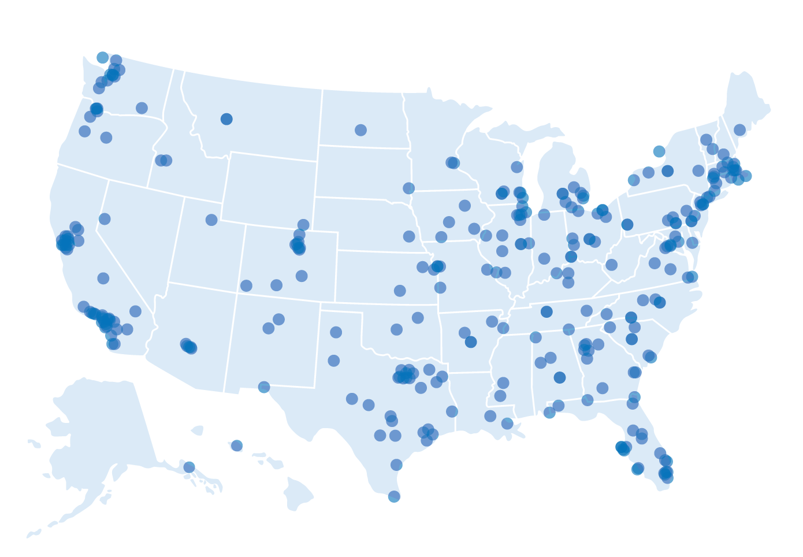
Procurement Excellence Network: Become a Member!
The Procurement Excellence Network has connected 2500+ government staff from 800 unique jurisdictions to procurement resources, best practices, and community support.
Attend monthly virtual webinars
Access over 80+ resources
Connect with peers in our Member Directory!
Community Conversations Dashboard
Become a Member!
Map of U.S. PEN Members

